Slide 1
How to Read Valmont calculations

Slide 2

Objectives
Understand the calculation and analysis information that is supplied by Valmont
Able to view base reactions summary on the Design Summary page

Slide 3

General Layout
You find the following information in each set of documents:
- Subject
- Code / Criteria
- Design Summary
- Pole
- Arms*
- Connection Data*
- Luminaire*
- EPA and Loading
- Results Summary
- Analysis
- Deflection
*
If applicable

Slide 4
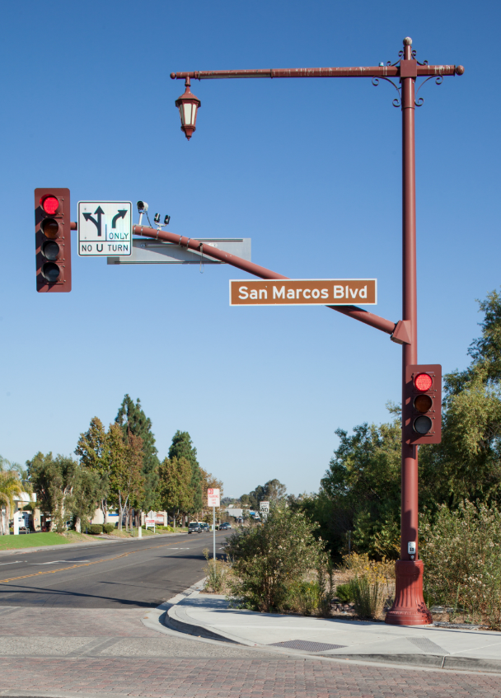
Page Layout by Code
Each set of calculations may be organized differently depending on what code is used. All calculations will have the same information, but may be found on different pages of the document.
Different layouts include:
- AASHTO 1994*
- AASHTO 2001
- AASHTO 2009
- AASHTO 2013*
- AASHTO 2015*
- IBC
- FBC
- Valmont Criteria
*
Covered in this presentation

Slide 5
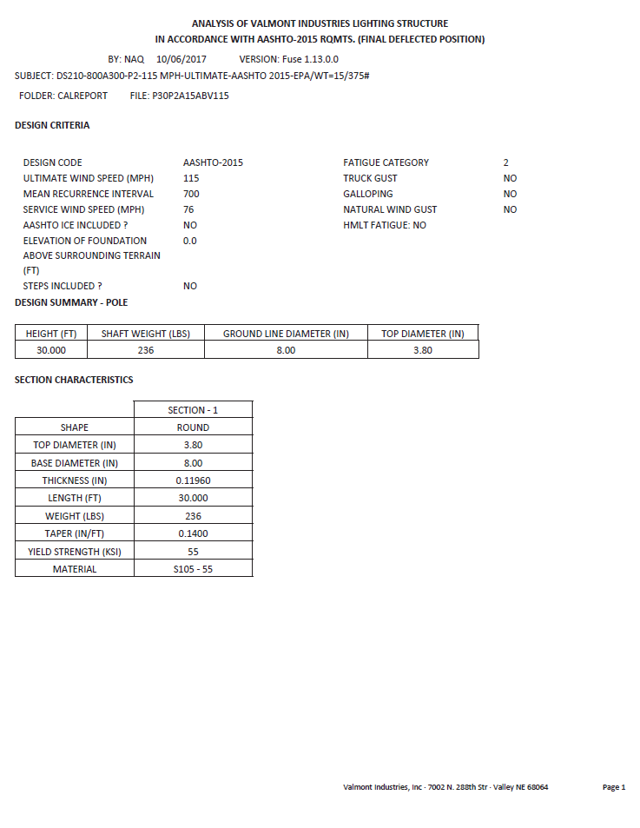
Subject
The subject is a summary of the pole design and contains summary of pertinent information, or design designation.
Additional Subjects may look like:

Slide 6
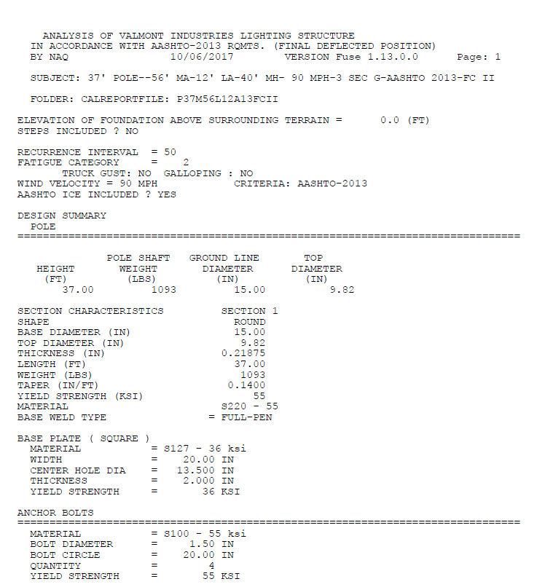

Code or Criteria
The criteria will be specifically stated on the first page of the calculations document. This information may also on additional pages.

Slide 7
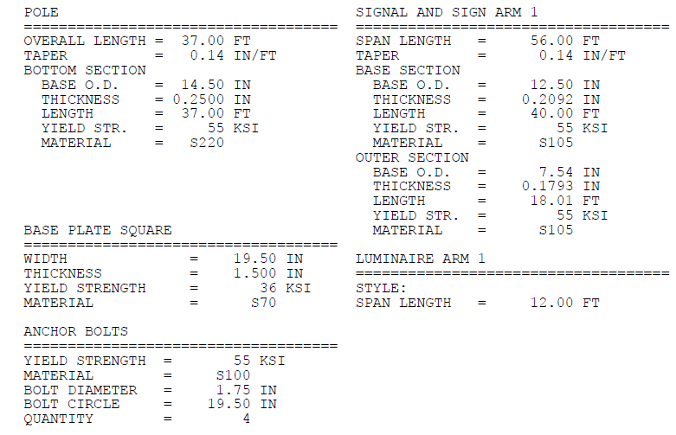
Design Summary
This page shows the summary description of the pole, base plate, anchor bolts, mast arm, and luminaire arm,

Slide 8
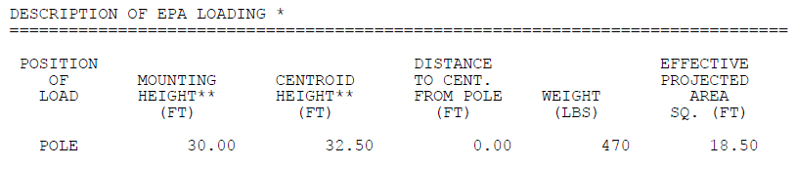
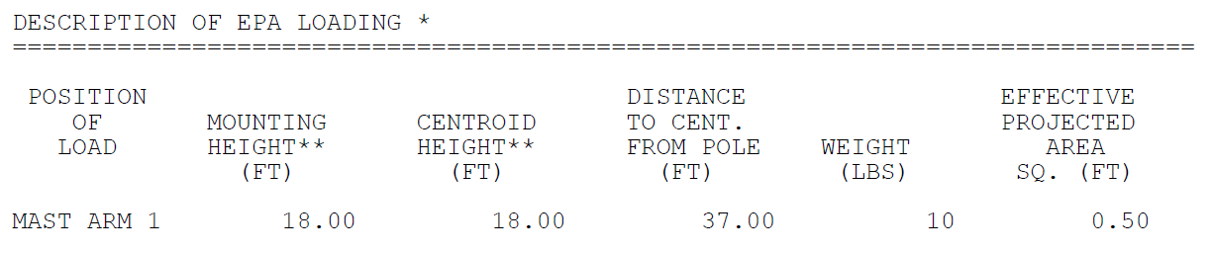
EPA Loading
This page shows the description of the EPA loading on both the pole and arm. EPA loading can come from cameras, fixtures, etc…

Slide 9
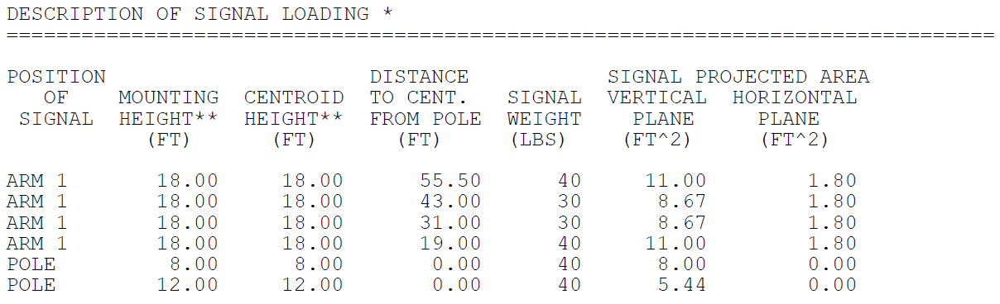
Loading
This description of signal loading on mast arm and pole. Including EPA, weight, and location.

Slide 10
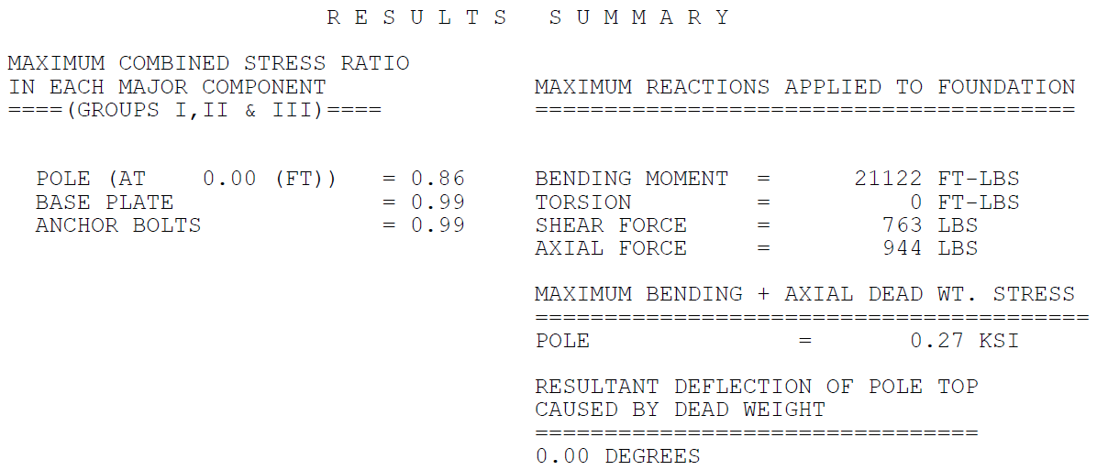
Results Summary
This is a description of the pole base reaction. This includes base movement, torsion, shear and axial load.
This information is used for designing foundations.
Pole dead weight deflection
On the left side shows the combined stress ratio (CSR) for all components of the design. A CSR ratio of 1 or less indicates adequate design.

Slide 11
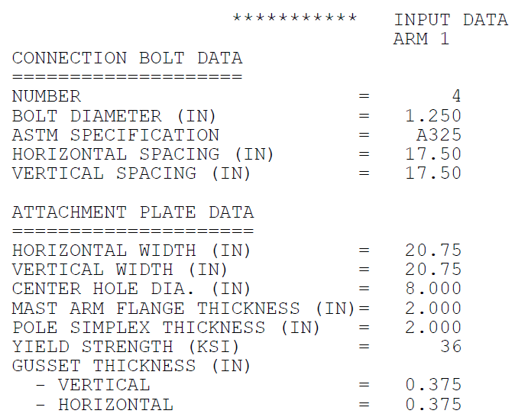
Analysis
The rest of the pages of the calculations show the detailed information behind the summary results. Information includes stresses at different locations, deflection, simplex, etc…

Slide 12
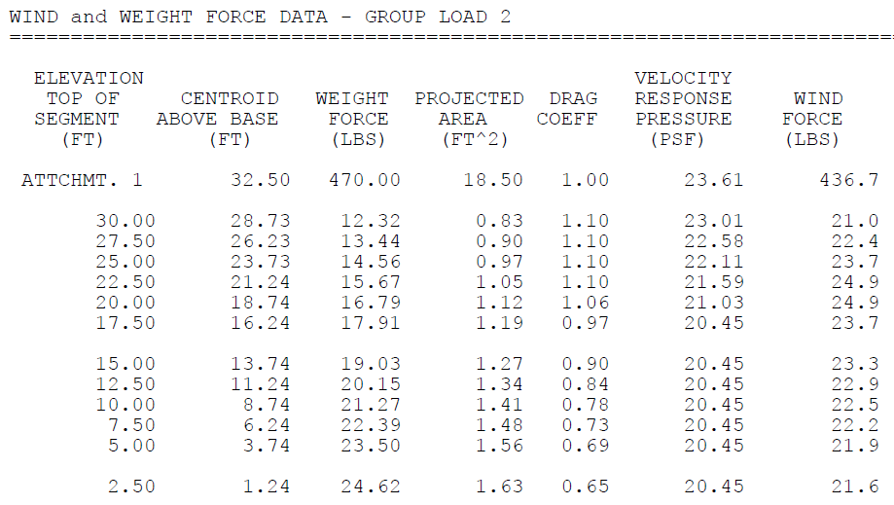
Deflection
To the right is pole deflection information. In many cases deflection limit is not specified. It may become pertinent for CCTV or camera pole designs where the customer wants to limit deflection to a certain percentage.

Slide 13
THANK YOU!
valmontstructures.com

